Slide 1



Fundamentals of Optoelectronics
（光电子学基础）
Prof. Zongyin Yang （杨宗银）
College of Information Science and Electronic Engineering,
Zhejiang University （浙江大学信息与电子工程学院）
Email：yangzongyin@zju.edu.cn
Website: optoelectronicszju.com
2025 春夏学期

Slide 2

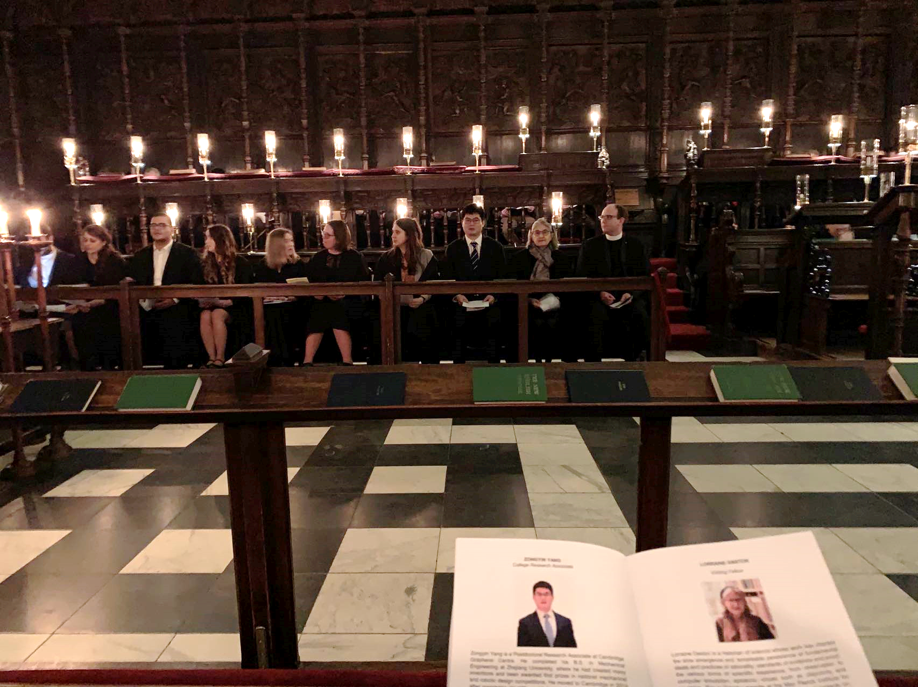
Self-introduction
1988.8 – 至今
喜欢拆电器，制作小发明，梦想从事电子技术研究
2005.9 – 2006.6
浙江大学，应用生物，本科
全国机械设计大赛一等奖
浙大机器人大赛二等奖
浙江省机械设计大赛二等奖
浙大机械设计大赛二等奖
浙大“挑战杯” 一等奖
浙大电路焊接大赛特等奖…
2006.9 – 2009.6
浙江大学，机械工程，本科
2009.9 – 2012.3
浙江大学，光学工程，硕士
导师：童利民 教授
2014.10 – 2019.1
剑桥大学，电子工程，博士
导师：Tawfique Hasan 副系主任
剑桥大学全额奖学金，全球仅80人
剑桥墨水公司创始董事
2019.4 – 2020.8
剑桥大学，电子工程，博后
导师：Andrea Ferrari 皇家工程院院士
2019.7 – 2020.8
剑桥大学，国王学院，研究员
Non-stipendiary Research Fellowship
2020.9 – 2024.8
浙江大学，信息与电子工程学院，“百人计划” 研究员
2024.8 – 至今
浙江大学，长聘教授，求是特聘教授

Slide 3
Self-introduction
发表论文、著作及专利
学术兼职与荣誉
在Science, Nature Photonics, Nature Electronics，Nature Communications, Science Advances 等期刊发表60余篇论文
Science 3篇（一作×2）Nature Photon. , Science Advances, Light, Engineering 通讯作者
中国专利20多项，申请英国专利2项，PCT专利4项
在Springer出版书本1部
担任INGEP2024国际会议执行主席，组织并担任OECC2023国际会议Workshop主席，受邀大会报告3次，华为STW会议1次，华为“罗马论坛”授课
Nature Nano., Nature Photon., Nature Commun., Science Advances 等期刊的审稿人
The Innovation (IF=32.1), 中国激光, FITEE 等杂志青年编委
Journal of Physics D（IF=3.2）等期刊专题编辑
国家优自奖“特等奖”，近年来英国理工科首位获得者
浙江大学启真优秀青年学者；青年创新奖
浙江大学校级优秀班主任，创新创业先进个人
第八届中国国际“互联网+”创新创业大赛 全国金奖
2024中国国际大学生创新大赛全国金奖+银奖
第十四届“挑战杯”创业竞赛全国金奖
浙江省国际大学生创新大赛金奖×4项
第七、八（冠军）、九届 浙江省“互联网+” 大赛 金奖
第十三、十四届浙江省“挑战杯” 创业计划竞赛 金奖
入选国家海外优青；浙江省创新长期项目（千人计划）
入选《麻省理工科技评论》 35岁科技35人 （TR35）
阿里巴巴达摩院“青橙奖”
华为“火花奖”（解决通讯光源识别难题，最高价值奖）
国家自然科学基金专项人才计划 (2700万，9年，杰青+)

Slide 4
Self-introduction
光谱 材料 | 首次提出移动衬底法生长渐变半导体材料 | Z. Yang et al., Nano Lett. 11, 5085 (2011)
Z. Y. Yang et al., Science 365, 1017 (2019) | 首次提出移动源法生长渐变半导体材料 | F. Gu*, Z. Yang* （并一）et al., J. Am. Chem. Soc. 133, 2037 (2011)
浙大硕士期间
光谱发光 | 最宽波长可调纳米激光器 | Z. Yang et al., Nano Lett. 14, 3153 (2014)
 | 波长连续可调纳米激光器 | M. Zhuge, Z. Yang et al., ACS Nano 13, 9965 (2019)
剑桥博士期间
微型光谱仪 | 世界最小光谱仪 | Z. Yang et al., Science 365, 1017 (2019)
 | 建立光谱仪微型化的理论和技术体系 | Z. Yang et al., Science 371, eabe0722 (2021)
 | 时间编码范德华异质结光谱仪 | Science 378, 296-299 (2022)
 | 多维信息感知评论论文 | Z. Y. Yang* et al., Nature Photonics (2024)
 | 拓扑编码解决高分辨率与高灵敏度无法兼具的难题 | … Z. Y. Yang* et al., Science Advances (2024)
 | 多体问题解决高分辨率和光谱范围无法兼具的难题 | …Z. Y. Yang* Light science & applications (2025)
 | 飞秒激光加工宽光谱色散铌酸锂光栅结构 | …Z. Y. Yang* et al., Nature Commun. (revision)
 | 基于应力调控的宽光谱范围光谱仪 | … Z. Y. Yang* et al., Science Advances (revision)
浙大独立PI成果

Slide 5
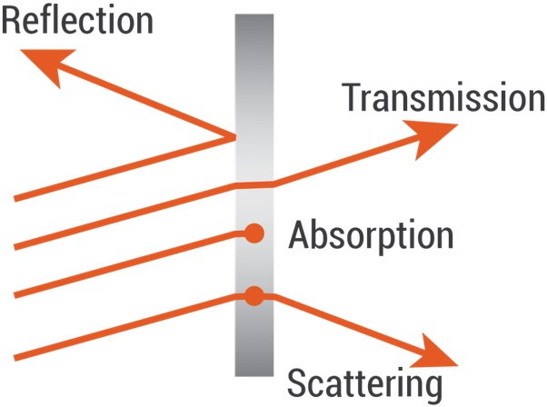
What is optoelectronics about?
(1) How does light interact with matter?
Emission
Governed by Schrödinger equation, Maxwell’s equations and semiconductor equations and so on.
(2) How can we create devices that manipulate light?
Optoelectronics is the communication between optics and electronics, includes the study of hardware that converts electrical energy into light or light into energy. For example, LED lighting, laser systems, fiber optic communications, photovoltaic (solar) systems, optical detectors that can source, detect, and control light.

Slide 6
Why do we learn optoelectronics?
(1) Faster: The frequency of light waves is much higher than that of microwaves, so optoelectronic communication has a higher bandwidth than microwave communication.
(2) Smaller: Optoelectronic devices are typically smaller than microwave devices because they operate at much higher frequencies and use much smaller wavelengths. This enables optoelectronic devices to be much smaller in size than microwave devices, which typically operate at lower frequencies and use longer wavelengths.
(3) Energy efficiency: Light-emitting diodes (LEDs) are optoelectronic devices that have revolutionized lighting by offering significantly higher energy efficiency and longer lifespans compared to traditional incandescent and fluorescent lighting.
(4) Cutting-edge: Optoelectronics is a relatively new field with many opportunities for innovation and discovery. Researchers are exploring new materials, devices, and techniques for improving the performance and efficiency of optoelectronic systems, which can lead to new applications and markets.

Slide 7
Tips on how to learn effectively
1.Break down the concepts: Breaking down the concept into smaller parts can make it easier to understand. Try to identify the key components of the concept and how they relate to each other.
2.Learning the history of physics: This can be a fascinating and enriching way to understand physics concepts. Knowing the history of physics allows you to understand the context in which the concepts were developed, and you can see how the concepts fit together into a bigger picture. You can understand the connections between different concepts and how they relate to each other. 点到面。
3.Use multiple sources: Use multiple sources such as textbooks, online AI, resources (知乎) , video tutorials (Youtube), and peer-reviewed articles to gain a comprehensive understanding.
4.Practice with hands-on projects: Optoelectronics is a hands-on field, and the best way to learn is by doing. You can start by building simple circuits and devices, such as LED flashlights, photodiode sensors, and fiber optic communication systems. As you gain more experience, you can work on more advanced projects.

Slide 8
Goals of the course
1. Learn the big picture of optics and electronics easily
草履虫也能听懂
2. Learn the simulation software
3. Learn how to give a presentation and write a report

Slide 9
Syllabus
1. Foundational Knowledge in Physics and Mathematics: Euler‘s formula，Fourier transform，Maxwell’s equations，Schrödinger equation, Band structures and so on. This forms the base for understanding how light interacts with electronic devices.
2. Study the fundamental optoelectronic devices: light-emitting diodes (LEDs), photodiodes, photodetectors, laser diodes, optical fibers and spectrometers. I will also invite some experts to introduce the cutting-edge research in their fields which are related to optoelectronics.
3. Learn the simulations, analysis, design and optimization of photonic devices: COMSOL, FDTD and MATLAB.
4. Hands-On Projects: complete a computational spectrometer project. The project includes design and simulation of metamaterials, developing an algorithm to reconstruct the spectrum, and write a report.

Slide 10
Grading
1. Questions and answers =10% (Greek Letters, learned in the last class)
2. Presentation = 15% (Make presentations of journal papers)
3. Assignments = 20% (MATLAB project)
4. Final project =55%: (Simulation 15%, algorithm 15%, report 25%)

Slide 11
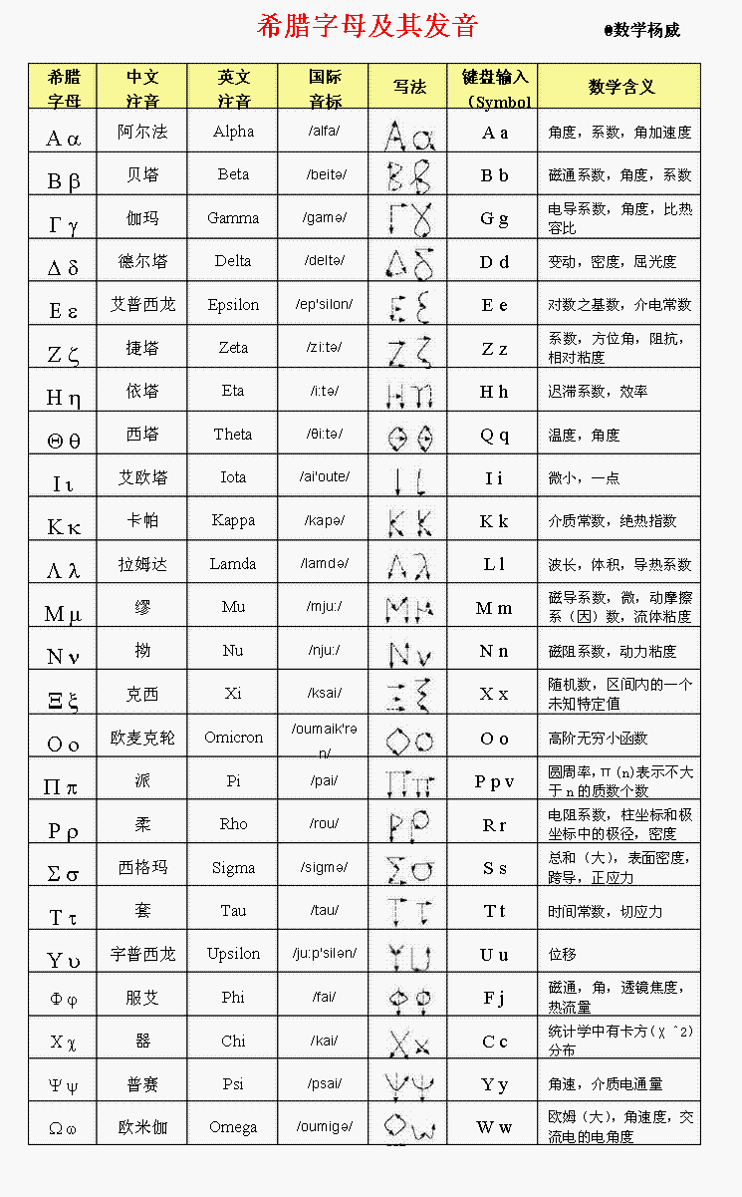
1. Roll call: Greek Letters
Greek Alphabet Symbols List

Slide 12
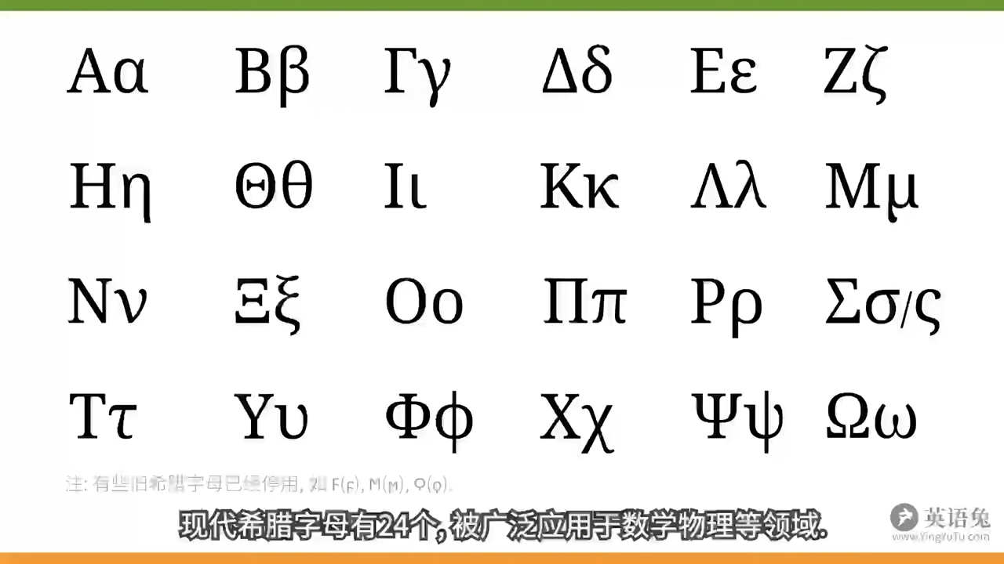
1. Roll call: Greek Letters

Slide 13
2. Presentation: Structure your presentation like a story
Introduction / Identify a problem: Brief overview of the context or problem you are addressing. 为什么做这件事，普及陌生的概念，听众兴趣：自身相关，悬念，社会需要
Literature review / background: Previous work, research, or theories relevant to the topic. 前人怎么做的（注意罗列，只列举和你要做的事情相关的部分）
Highlight the Challenges: Identify and explain the main challenges encountered by other researchers. 该领域存在的问题，难点
Explain the Reasons Behind Challenges: Dive deeper into why these challenges exist. 从难点中提炼科学问题，即难以解决的原因
Connection to Your Work: Explain how your research/method contributes to addressing these challenges. 你去解决这些科学问题的创新方法是什么
Results: Present the main results or conclusions from your work, research, or findings to support your research or a technical solution. 用结果证明你的假设或方法是可行的
Implications: Highlight the significance. What does your work mean for the field, and what should be done next? 你的方法产生什么影响，潜在应用，后续工作
Summary of key findings: Briefly revisit the most important points.
没听懂的或走神的听众还有最后一次机会可以补救

Slide 14
2. Presentation: Key elements of a good presentation
Clear Structure: A well-organized presentation with a logical flow is crucial. The audience should easily follow the progression from one point to the next.
故事逻辑
Concise Content: Avoid overwhelming your audience with too much information. Stick to the key points that are most relevant to your purpose and audience.
简洁明了，直击听众关注的点
Simple, Clean Slides: Clear slides: Don't overload your slides with text; use bullet points and visuals to aid understanding.
Consistent Design: Use a consistent font, color scheme, and layout throughout the presentation for a professional look.
High-Quality Images: Ensure any images or visuals used are clear, relevant, and high-quality. Avoid clutter.
References (professional): Cite the sources or research papers that you referenced in your presentation.

Slide 15
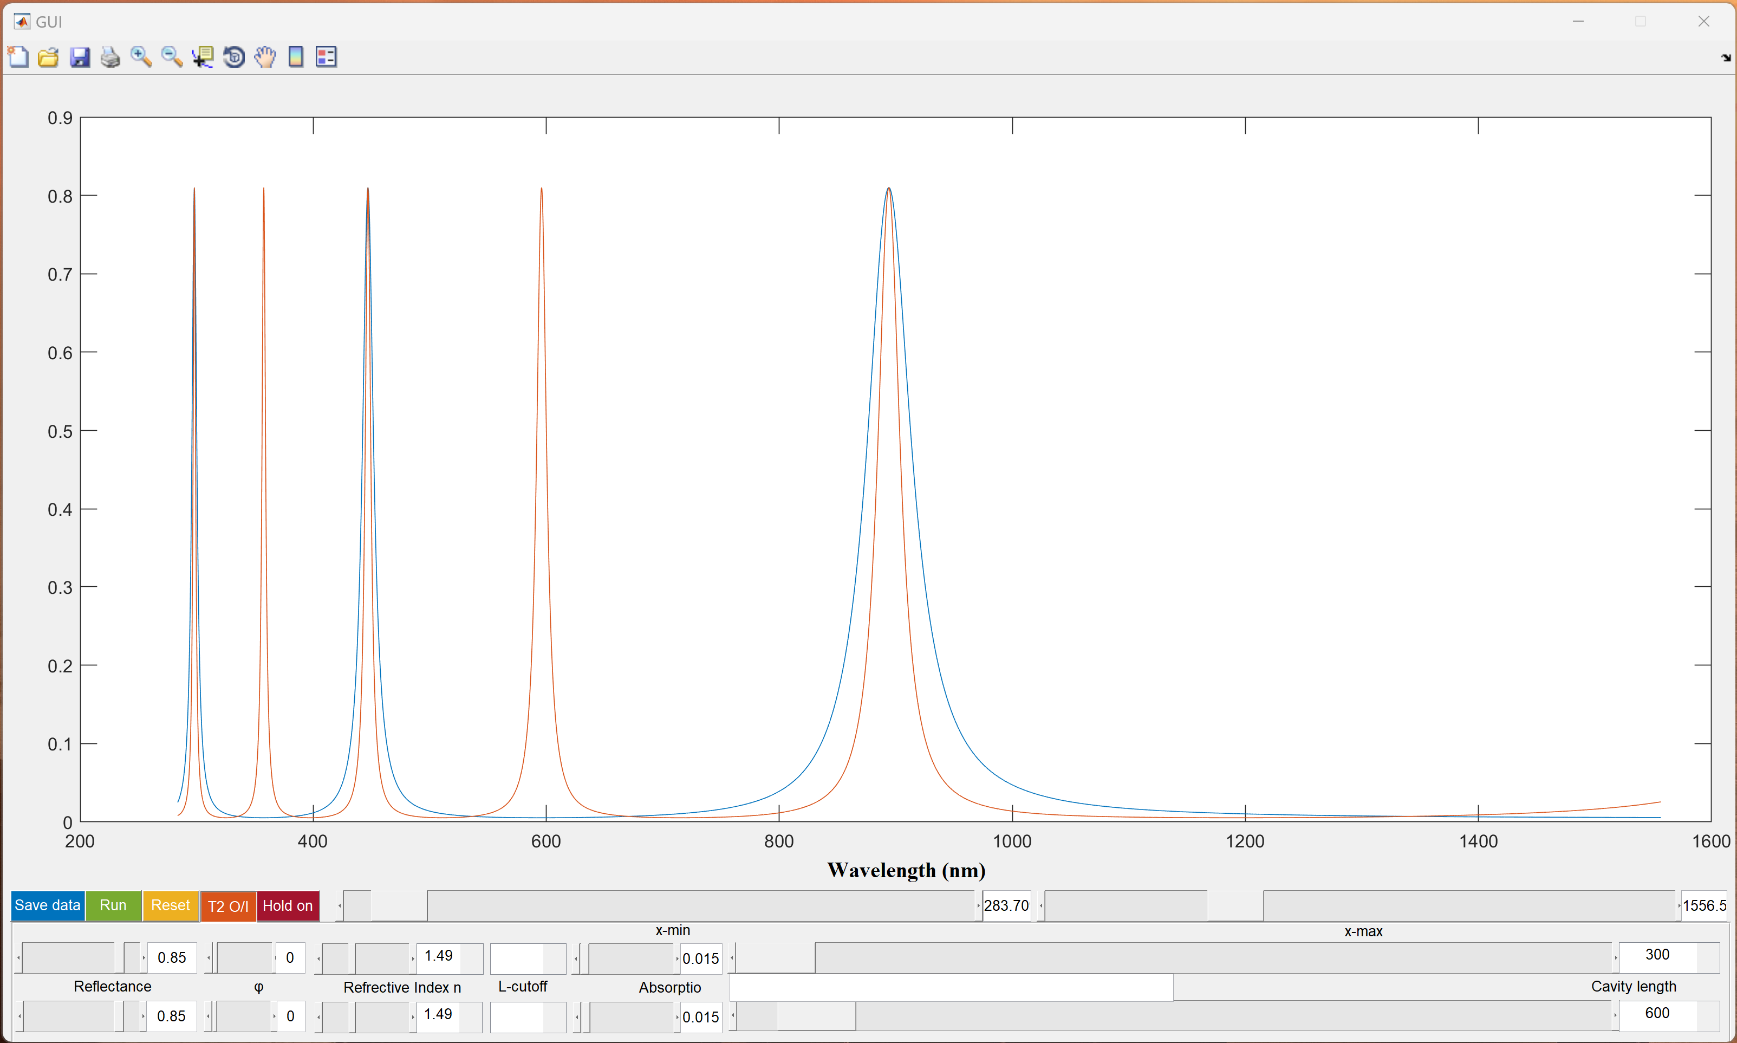
3. Assignment: Development of Matlab project

Slide 16
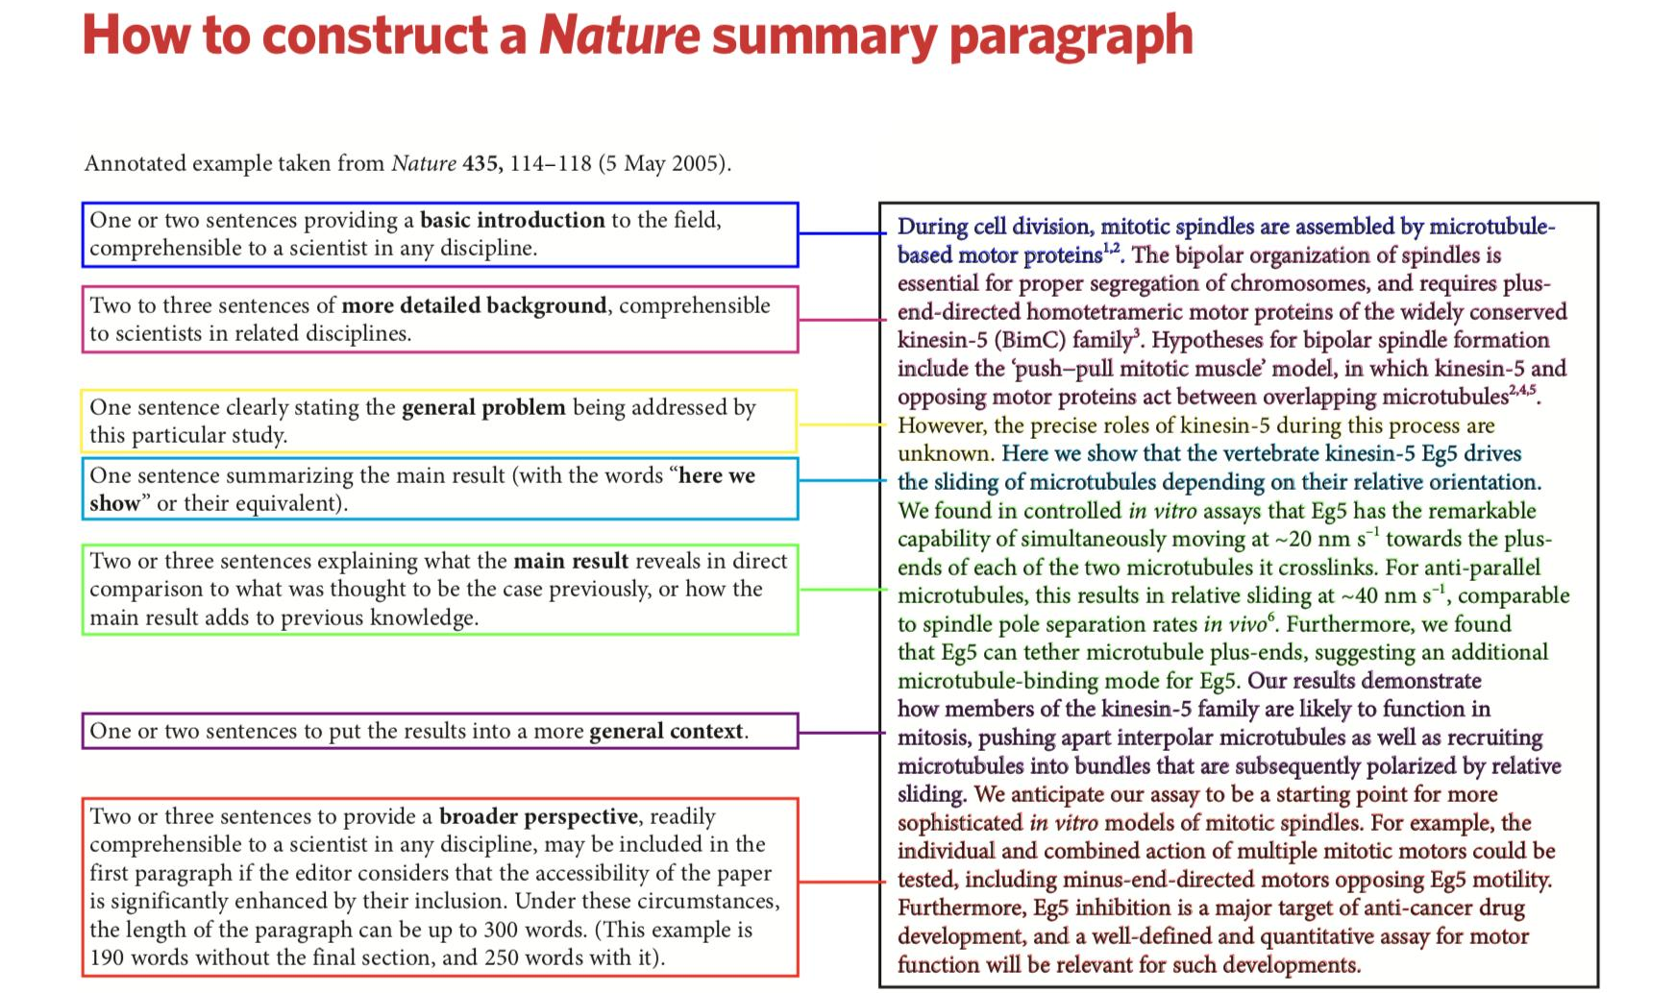
4. Final project: How to summarize a paper/report
专家在看报告或申请书其实就在找几个点：存在什么问题，你的创新方法是什么，你的研究内容和结果，你的论文专利是结果的佐证而不是创新或者结果本身，应用前景怎么样。

Slide 17
Reference books
Fundamentals of Photonics, Third Edition, Bahaa E. A. Saleh; Malvin Carl Teich, 2019.
Optoelectronics and Photonics: Principles and Practices, First Edition, S. O. Kasap, Prentice Hall, 2001.
半导体物理学，刘恩科编著. 电子工业出版社， 2008.
光电子技术基础，朱京平编著. 科学出版社, 2003.

Slide 18
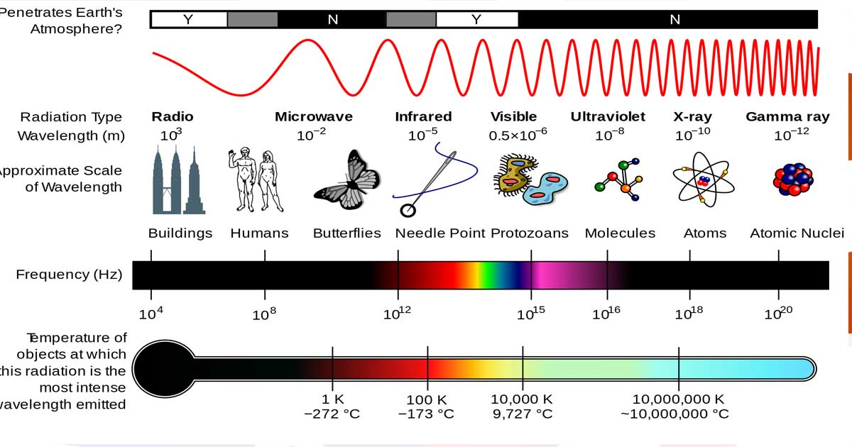
Light – electromagnetic
The electromagnetic spectrum from low frequencies (long wavelengths) to high frequencies (short wavelengths).

Slide 19
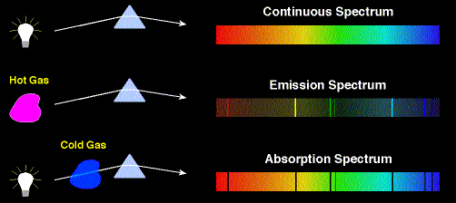
How Light and Matter are Studied: Spectra
Some hot media emit light with broad continuous spectra (like a light bulb):
Spectrometer
Some hot media (hot atomic gases) emit only a few frequencies of light:
Spectrometer
A cold gas absorbs some frequencies from light with a broad continuous spectrum:

Slide 20
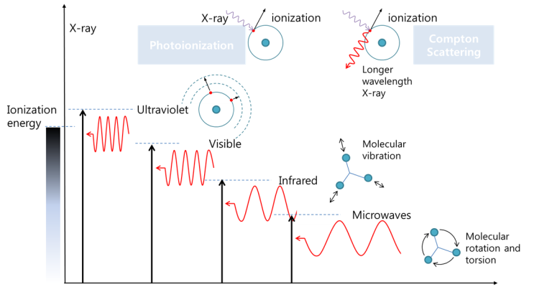
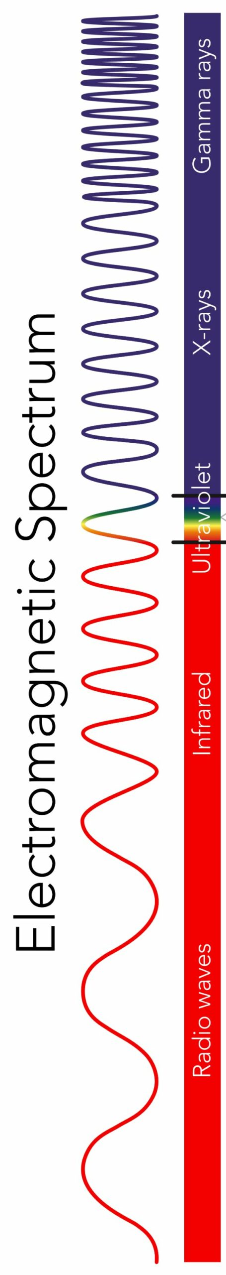
Various interactions of radiation with matter
Atomic spectroscopy

Slide 21
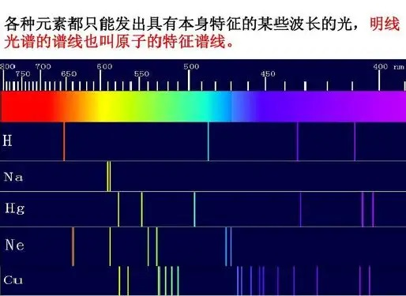
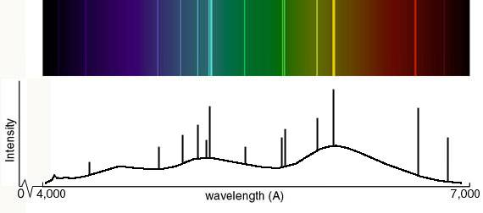
Atomic spectroscopy
Atomic spectroscopy is the study of the electromagnetic radiation absorbed and emitted by atoms. Since unique elements have unique emission spectra, atomic spectroscopy is applied for determination of elemental compositions.

Slide 22
Various interactions of radiation with matter
Molecule spectroscopy

Slide 23
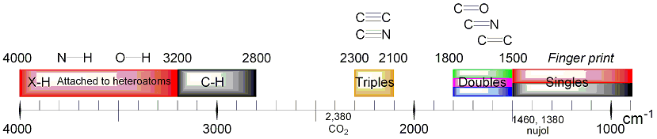
Vibrational Frequencies for Various Bonds
Different bonds have different vibrational frequencies (which are also affected by other nearby atoms).
← Higher energy (frequency)
Wavenumber (cm⁻¹)
Notice that bonds containing Hydrogen vibrate faster because H is lighter.
Triple bonds, of three pairs of electrons, have larger spring constants and hence higher vibrational frequencies.
Bonds involving heavier atoms, like carbon, vibrate more slowly.

Slide 24
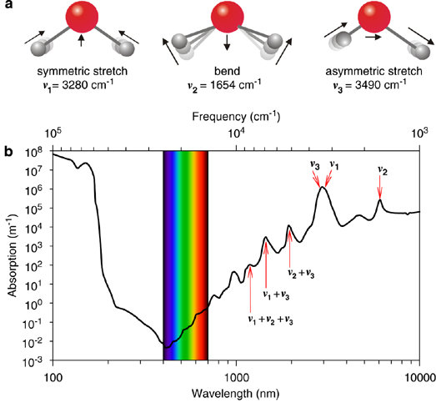
Water’s Vibrations
Note that each has a different frequency, and combinations of them are also possible.

Slide 25
Various interactions of radiation with matter
Microwave spectroscopy

Slide 26
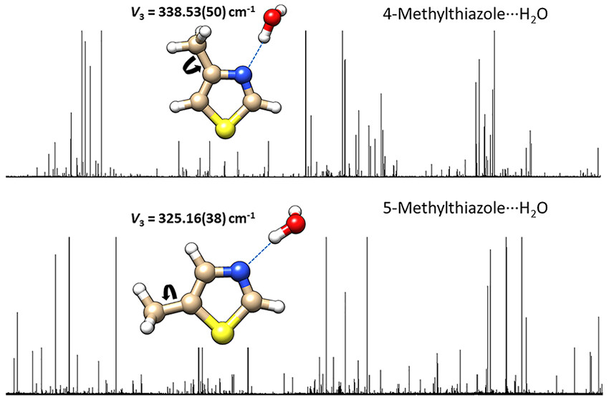
Microwave spectroscopy
Microwave spectroscopy employs electromagnetic radiation at GHz frequencies, for the study of matter and is commonly used to probe the rotation of molecules.

Slide 27
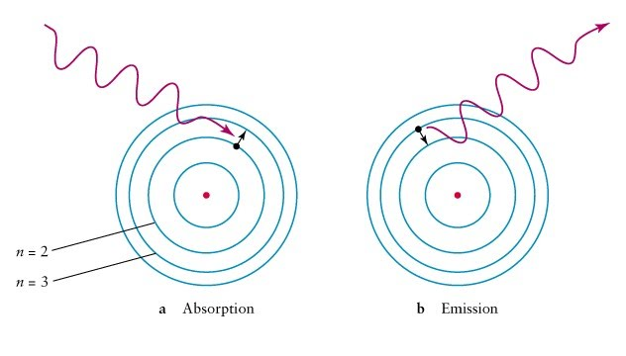
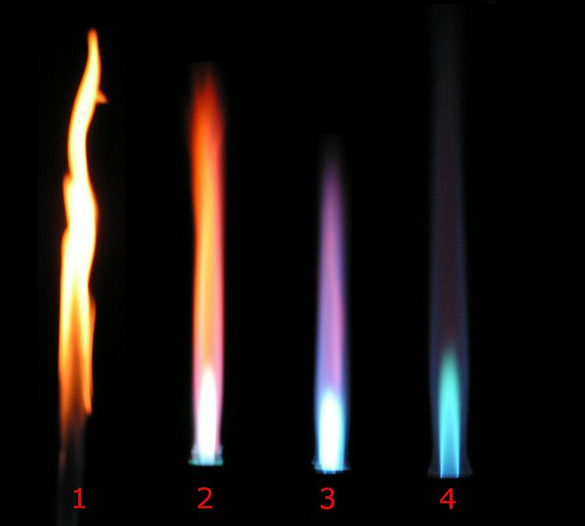
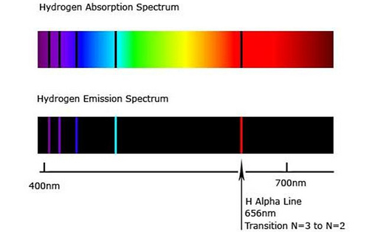
How does light interact with atom
Photons are absorbed when an electron jumps from a low energy state to a high energy state.
Spontaneous emission is when an electron jumps from a high energy state to a low energy state.
Colorful gasses
The atoms only absorbed at the certain wavelengths because this corresponded to the difference between two energy levels.
The excited state atom eventually returns to the ground state by emitting radiation. The bright lines appear at exactly the same wavelength as the light that was absorbed.

Slide 28
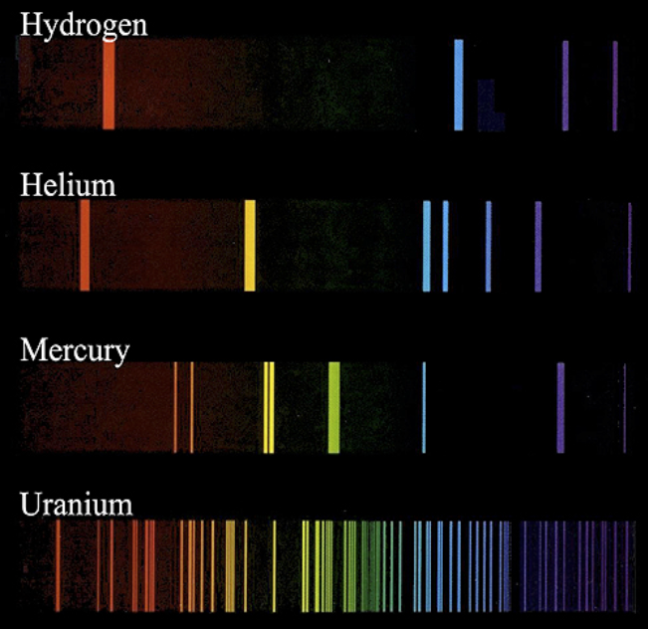
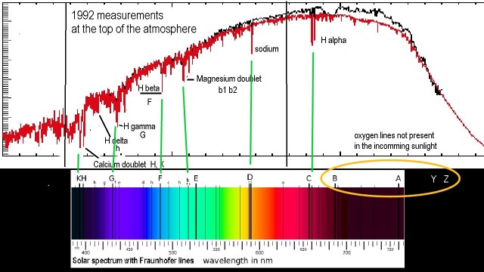
Atomic spectroscopy application
1814年，德国物理学家夫琅禾费设计了包含狭缝、色散棱镜和观察镜的分光光学系统，用它来观察太阳光，并发现了太阳光谱中的吸收暗线-夫琅禾费线。
Each element has a unique pattern of colors called fingerprint.
Astronomers use this fingerprint to determine the composition of distant stars
Doppler effect on lines：radial velocity, spin

Slide 29
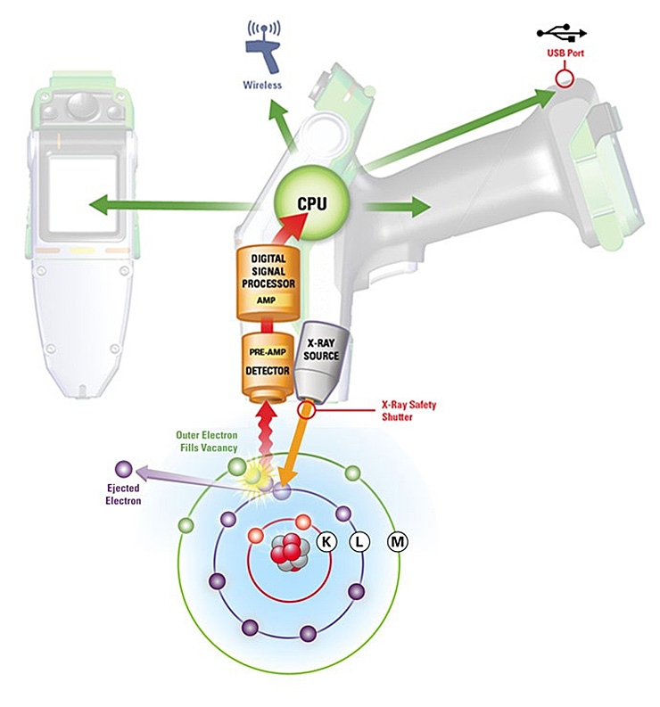
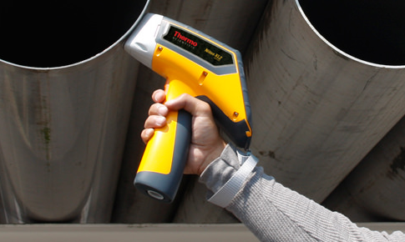
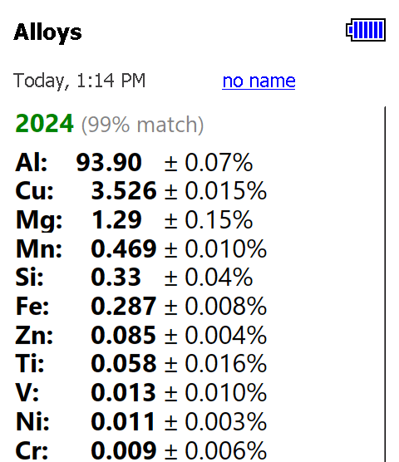
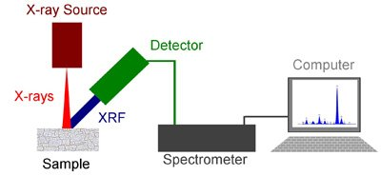
Atomic spectroscopy application
原子光谱仪： 原子吸收光谱仪（AAS）、X射线光谱仪（XRF、XRD和XPS）、火花/电弧/辉光放电光谱仪、等离子体光谱仪（LIBS和ICP-OES）

Slide 30
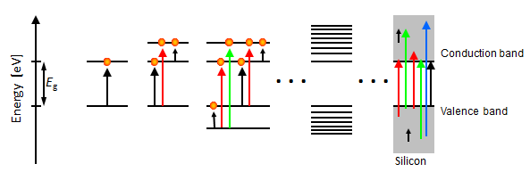
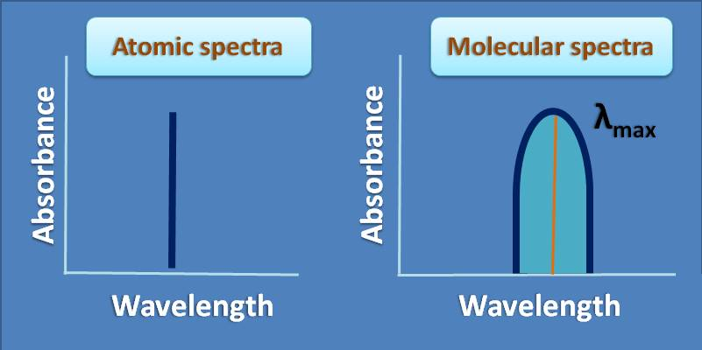
How does light interact with matter?
A two-level system (left) can absorb light only at a certain energy (or wavelength). So the atomic absorption spectra consist of a series of sharp, well defined lines.
With an increasing number of energy levels (toward the right), a broader energy (or wavelength) range of light can be absorbed.

Slide 31
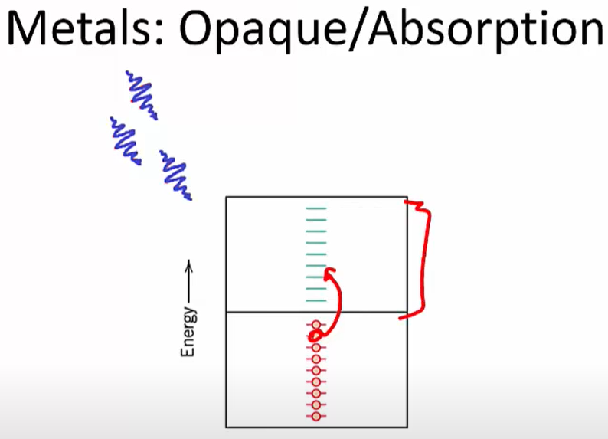
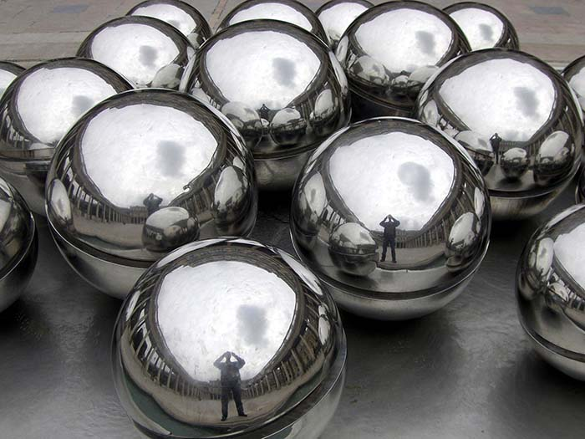
Light absorption in matter
When light waves hit a metal surface, they interact with the electrons in the metal atoms, causing the electrons to absorb some of the energy from the light waves.
The absorbed energy causes the electrons to become excited and move to a higher energy level within the metal atoms. However, because the excited electrons are not stable at this higher energy level, they quickly release the absorbed energy by emitting a new wave of light that is identical to the original incoming light wave.
This process of absorption and re-emission happens very quickly and repeatedly, which causes the incoming light waves to be reflected off the metal surface, rather than being absorbed or transmitted through it.

Slide 32
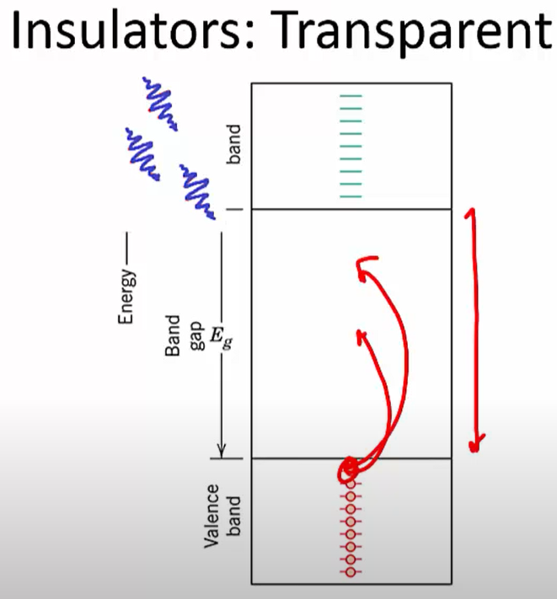

Light absorption in matter
If the energy of light waves is less than energy of the band gap, it will not be absorbed. To absorb a photon, there must be an available energy level to accept the excited electron.
Insulators tend to have a very wide band gap, larger than the energy of visible photons. The light waves are able to pass through the glass without being significantly affected.
When light enters a medium like water, it interacts with the molecules in the water, causing it to be absorbed and then re-emitted by these molecules.

Slide 33
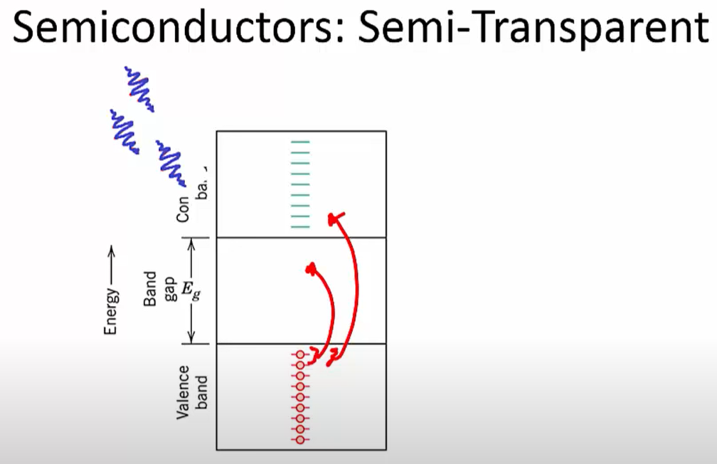
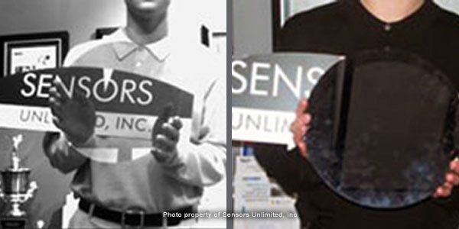
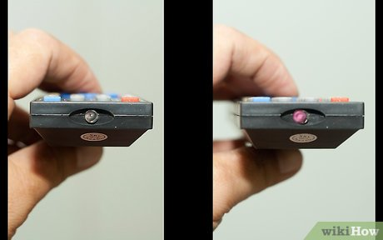
Light absorption in matter
Visible light camera
Selectively transparent
Infrared camera
Silicon does not absorb below the band gap energy of 1.14 eV (≈1100 nm)

Slide 34
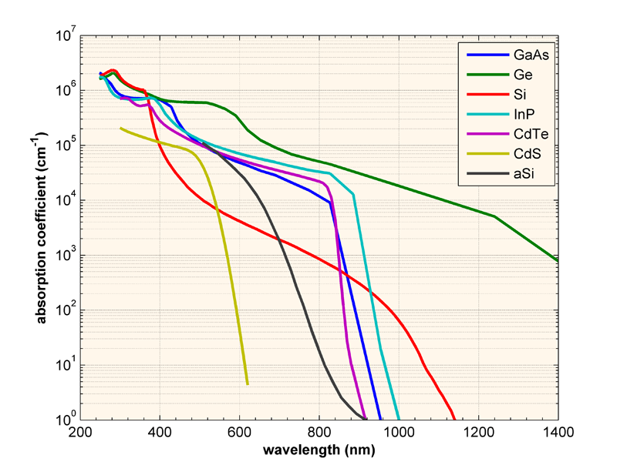

Light absorption in matter
In direct band gap materials the absorption coefficient is described by:

Slide 35
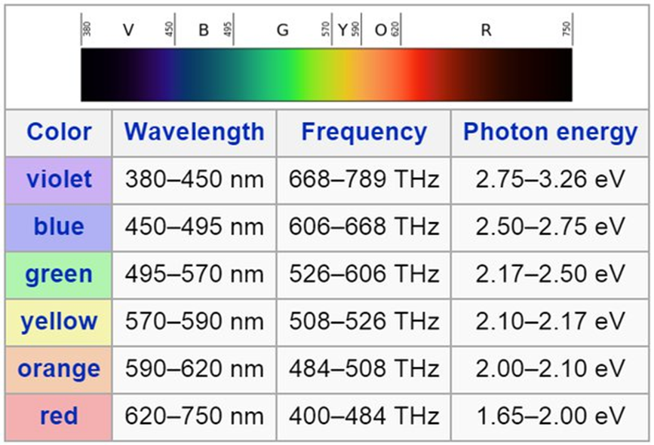
Convert from electron volts (eV) to wavelength(nm)
Planck's constant gives the relationship between the energy of a photon and its frequency. Specifically, a photon's energy is equal to its frequency multiplied by the Planck constant.
E = hc/λ
h = Planck's constant = 4.135667516 x 10⁻¹⁵ eV*s
c = speed of light = 299792458 m/s
Trick：
1240 eVnm ÷ (wavelength(nm)) = Energy in eV
eg.
Silicon’s band gap is 1.1 eV ~ 1100 nm

Slide 36
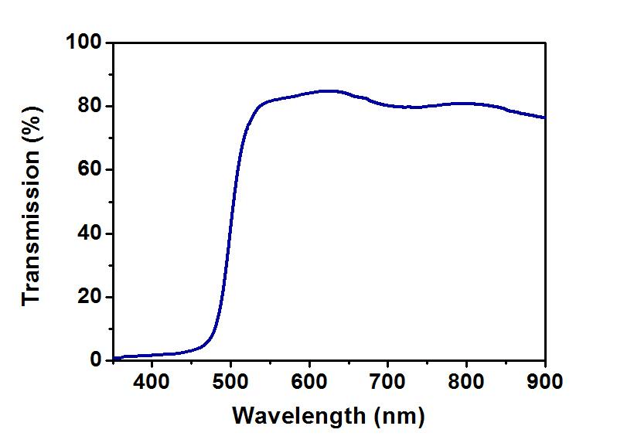
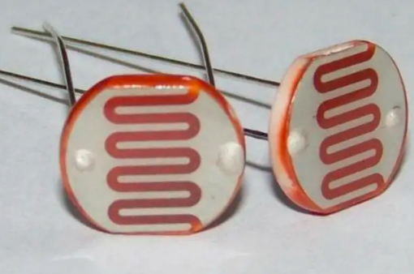
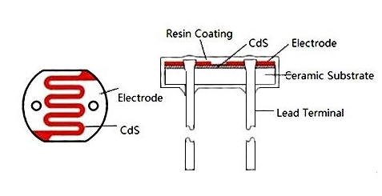
Quiz
The electrical conductivity of a semiconductor increases when an electromagnetic radiation of wavelength shorter than 514 nm is incident on it. The band gap of the semiconductor is? eV
2.42 eV

Slide 37
Vibrations and Rotations: Fluorescence Spectroscopy
Infrared and microwave spectroscopy allows the study of vibrational and rotational transitions and states.
But it’s often difficult to generate and detect the required mid-IR or even microwave light.
It’s easier to work in the visible or near-IR, exciting a molecule to an electronically excited state and measuring the emitted light’s spectrum.
2
Input light
Output light
ΔE
1
0

Slide 38
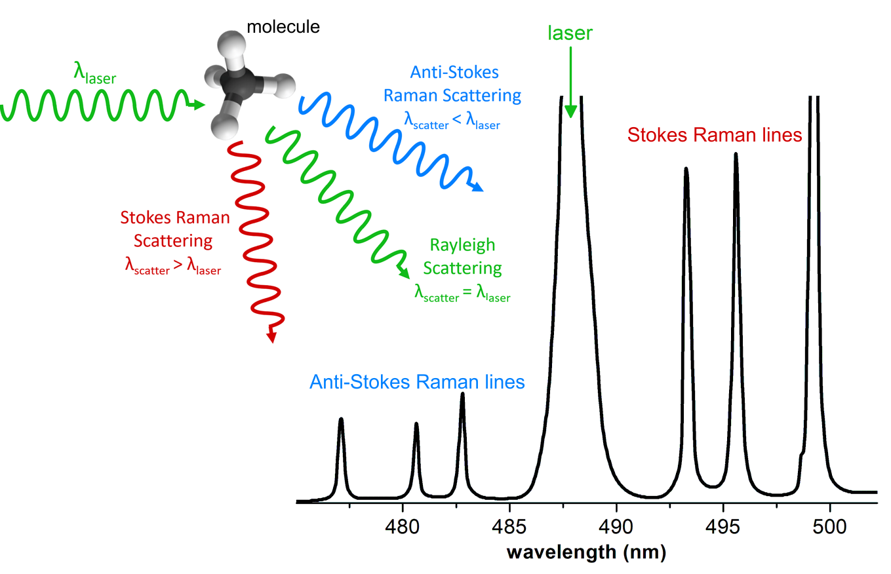
Raman Scattering

Slide 39
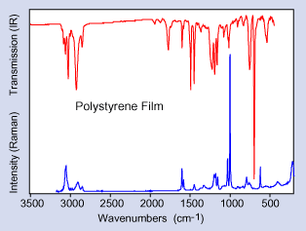
Raman Scattering
Absorption
Polystyrene film
Raman
The Raman spectrum is background-free and less busy and so more easily identified in a medium containing additional molecular species.

Slide 40
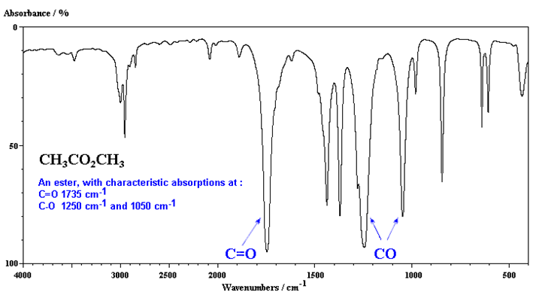
Convert from wavenumber (cm⁻¹) to wavelength (nm)
ṽ = 1/λ
λ = wavelength (m)=10⁹ nm
ṽ = wavenumber (m⁻¹)=10⁻² cm⁻¹
Trick：
10⁷÷ (wavelength(nm)) = wavenumber in cm⁻¹

Slide 41
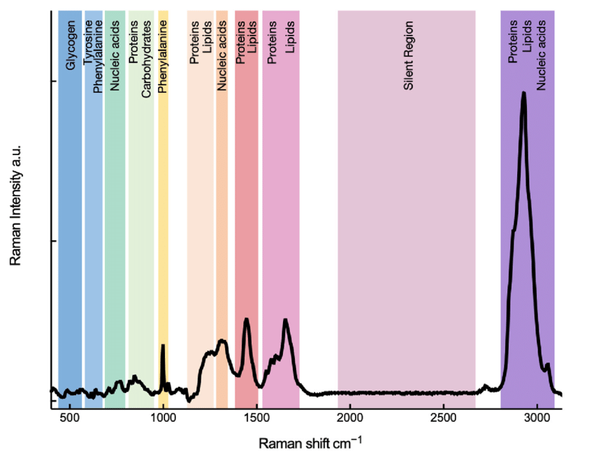
Convert from wavenumber (cm⁻¹) to wavelength (nm)
The excitation wavelength is 785 nm. Can you calculate the wavelength of the Raman scattering wavenumber at 3000 cm⁻¹

